Slide 1
NAME: VISHAL SK NM-ID:au711721243126 KGiSL Institute Of Technology
Language Modellling

Slide 2
PROJECT TITLE
Exploring Advanced Language Modeling Techniques for Natural Language Understanding"

Slide 3


AGENDA
Problem Statement.
Project Overview.
End Users.
Our Solution and Proposition.
Key Features.
Modelling Approach
Results and Evaluation
3/21/2024 Annual Review

Slide 4

PROBLEM STATEMENT
Build a PyTorch model that generates text continuations from input characters. Preprocess data, train the model, and evaluate its performance. Use techniques like BPTT for training and temperature scaling for text generation. Document the process and aim for a robust model capturing text patterns effectively.

Slide 5

PROJECT OVERVIEW
Goal: Create a model to generate text continuations from input characters.
Data Prep: Use short sentence data, tokenize characters, and encode them numerically with padding.
Model: Build an RNN-based model in PyTorch, adjusting hidden dimensions and layers for optimization.
Training and Evaluation: Train the model with BPTT and teacher forcing, monitoring loss. Assess performance with cross-entropy loss and qualitative analysis.
Text Generation: Develop functions for generating text based on the trained model, enhancing diversity with techniques like temperature scaling. Document the process and findings comprehensively.

Slide 6

WHO ARE THE END USERS?
1.Developers/Researchers: Those interested in NLP and text generation for research or development purposes.
Content Creators/Writers: Writers or bloggers seeking assistance with brainstorming and generating content ideas.
Educators/Students: Those studying NLP or machine learning, using the project for educational purposes.
AI Enthusiasts/Hobbyists: Individuals interested in experimenting with NLP and machine learning models.
Businesses/Enterprises: Companies looking to enhance text-based applications like chatbots or recommendation systems.

Slide 7

YOUR SOLUTION AND ITS VALUE PROPOSITION
This PyTorch code for training a character-level language model could be utilized by various stakeholders. It may interest developers seeking to create text generation applications like chatbots or virtual assistants, or those building language understanding tools such as sentiment analysis systems. Additionally, it could serve as an educational resource for students studying natural language processing or researchers investigating machine learning techniques. Companies involved in product development, particularly in areas like smart speakers or search engines, might also find value in integrating this language model into their systems to enhance text-related features.

Slide 8

THE WOW IN YOUR SOLUTION
Data Preparation: Concatenate input sentences, create dictionaries mapping characters to integers and vice versa, and pad sequences to the maximum length.
Model Architecture: Implement an RNN model with one-hot encoding input layer, an RNN layer, and a fully connected layer for output prediction.
Training: Define hyperparameters, loss function, optimizer, and train the model using input and target sequences.
Inference: Implement functions for predicting characters given a starting sequence and generating text samples based on the trained model.
End Users: Developers, researchers, content creators, educators, hobbyists, and businesses interested in NLP, text generation, and application development benefit from this project.
3/21/2024 Annual Review
8

Slide 9
MODELLING
The provided code implements a character-level language model using PyTorch. It begins by preprocessing the input text data, encoding characters into integers and performing one-hot encoding. Then, it defines a recurrent neural network (RNN) model with a specified number of layers and hidden dimensions. During training, it uses cross-entropy loss and the Adam optimizer. The model is trained for a specified number of epochs, with periodic printing of the loss. Additionally, it includes functions for generating text samples based on a provided starting sequence. Overall, this code serves as a foundational framework for training and utilizing a character-level language model in PyTorch.
9

Slide 10
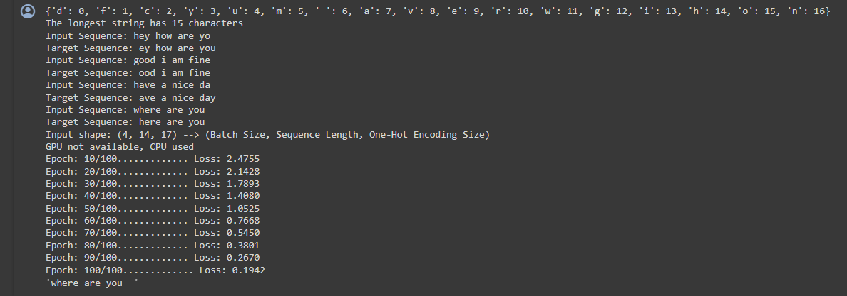
RESULTS
CONCLUSION
This project implements a character-level language model using PyTorch. By training on text data, the model learns to generate similar sequences of characters. With recurrent neural networks (RNNs) and optimization techniques, it refines its predictions over time. The result is a tool capable of generating coherent text based on user-defined starting sequences.
10

